Slide 1
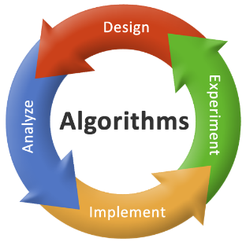
2CS503 Design & Analysis of Algorithm Recurrence Relation
Unit-3
Divide and Conquer Algorithm

Slide 2
Topics to be covered
Introduction to Recurrence Equation
Different methods to solve recurrence
Divide and Conquer Technique
Multiplying large Integers Problem
Problem Solving using divide and conquer algorithm –
Binary Search
Sorting (Merge Sort, Quick Sort)
Matrix Multiplication
Exponential

Slide 3
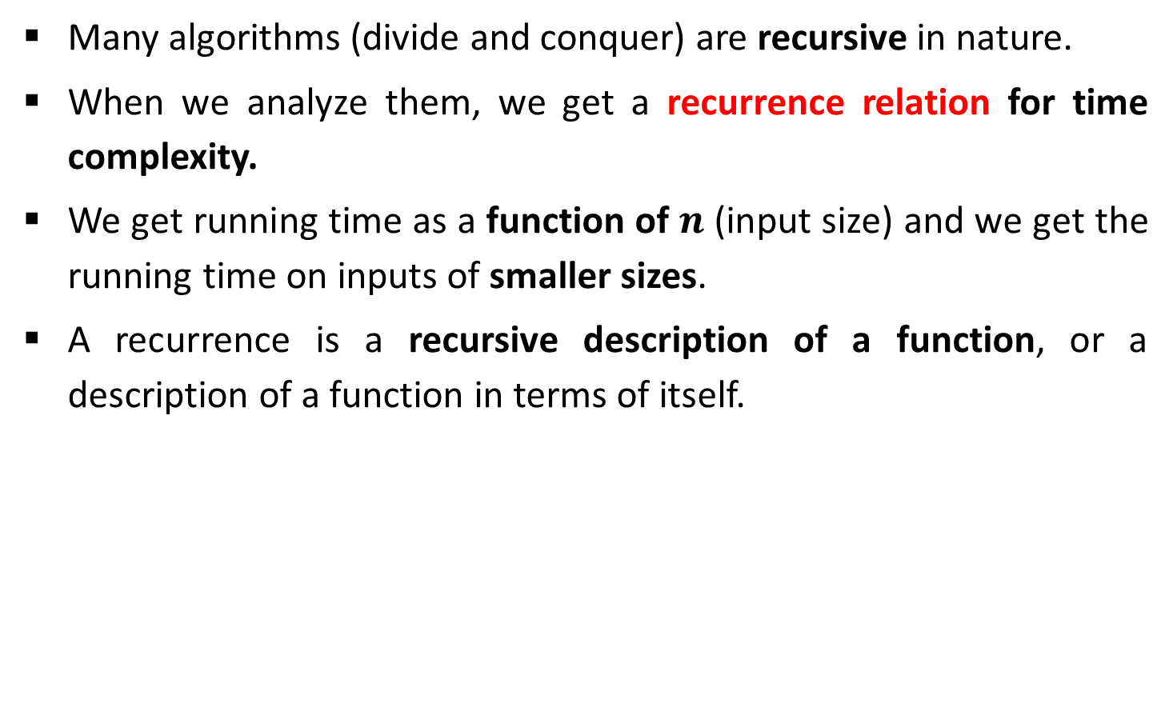
Introduction
Many algorithms (divide and conquer) are recursive in nature.
When we analyze them, we get a recurrence relation for time complexity.
We get running time as a function of $n$ (input size) and we get the running time on inputs of smaller sizes.
A recurrence is a recursive description of a function, or a description of a function in terms of itself.

Slide 4
Methods to Solve Recurrence
Substitution
Homogeneous (characteristic equation)
Non-homogeneous
Master method
Recurrence tree
Intelligent guess work
Change of variable
Range transformations

Slide 5

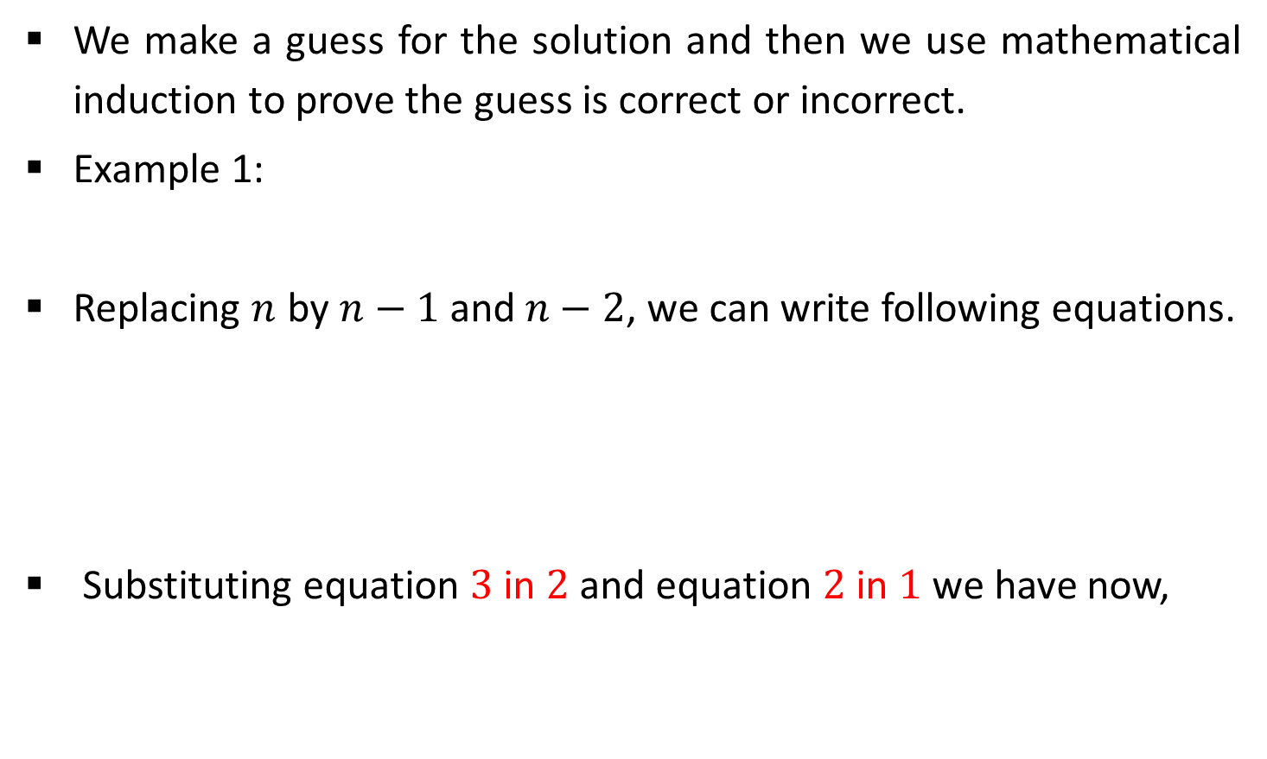



Substitution Method
We make a guess for the solution and then we use mathematical induction to prove the guess is correct or incorrect.
Example 1:
Replacing $n$ by $n−1$ and $n−2$, we can write following equations.
Substituting equation $3$ in $2$ and equation $2$ in $1$ we have now,
$$T(n)=T(n−1)+n$$
1
$$T(n−1)=T(n−2)+n−1$$
2
$$T(n−2)=T(n−3)+n−2$$
3
$$T(n)=T(n−3)+n−2+n−1+n$$
4

Slide 6

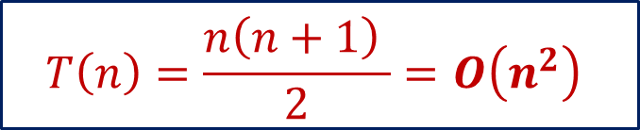
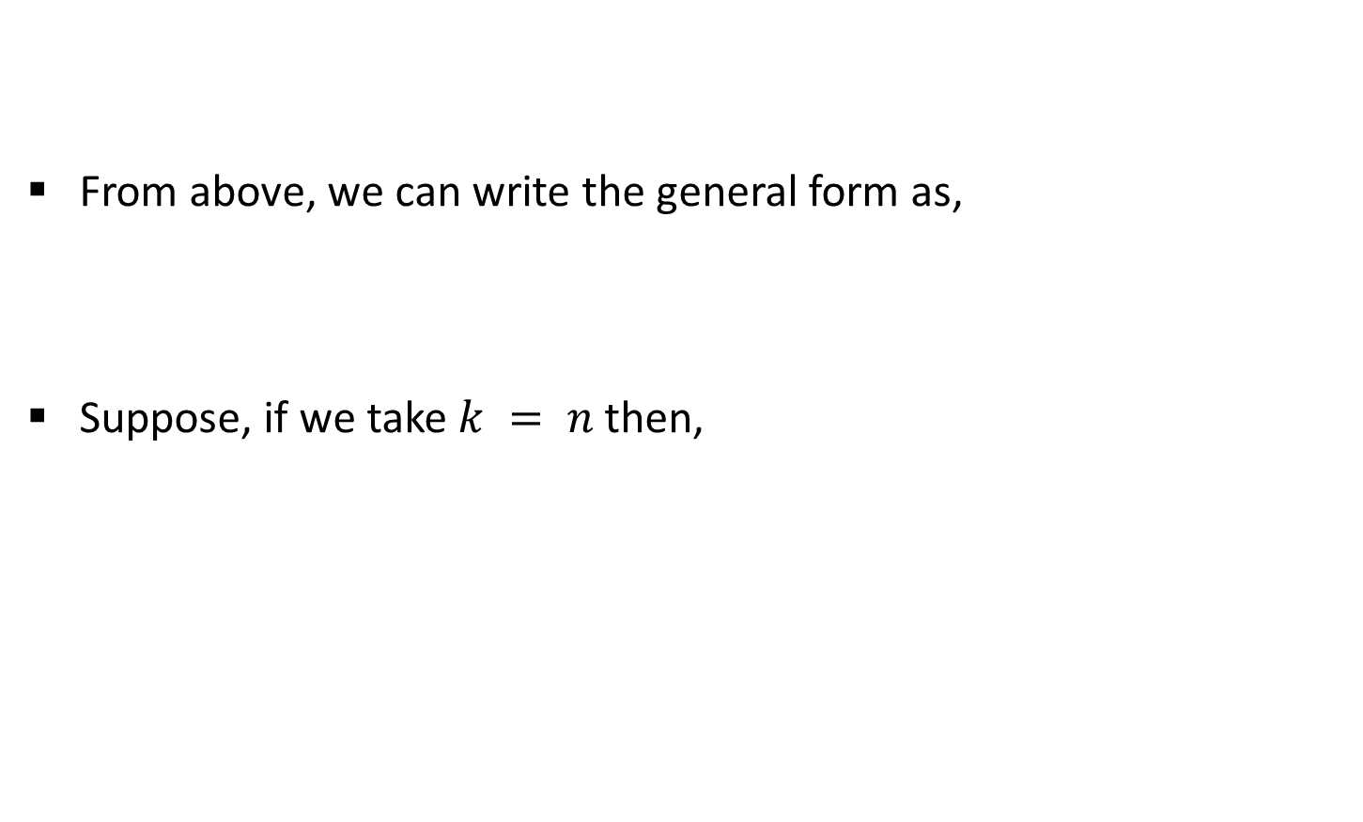

Substitution Method
From above, we can write the general form as,
Suppose, if we take $k = n$then,
$$T(n)=T(n−3)+n−2+n−1+n$$
4
$$T\left(n\right)=T\left(n−k\right)+(n−k+1)+(n−k+2)+ …+n$$
$$T(n)=T(n−n)+n−n+1+n−n+2+ …+n$$
$$T\left(n\right)=0+1+2+ …+n$$
$$T\left(n\right)=\frac{n\left(n+1\right) }{2}=O\left(n^{2}\right)$$

Slide 7
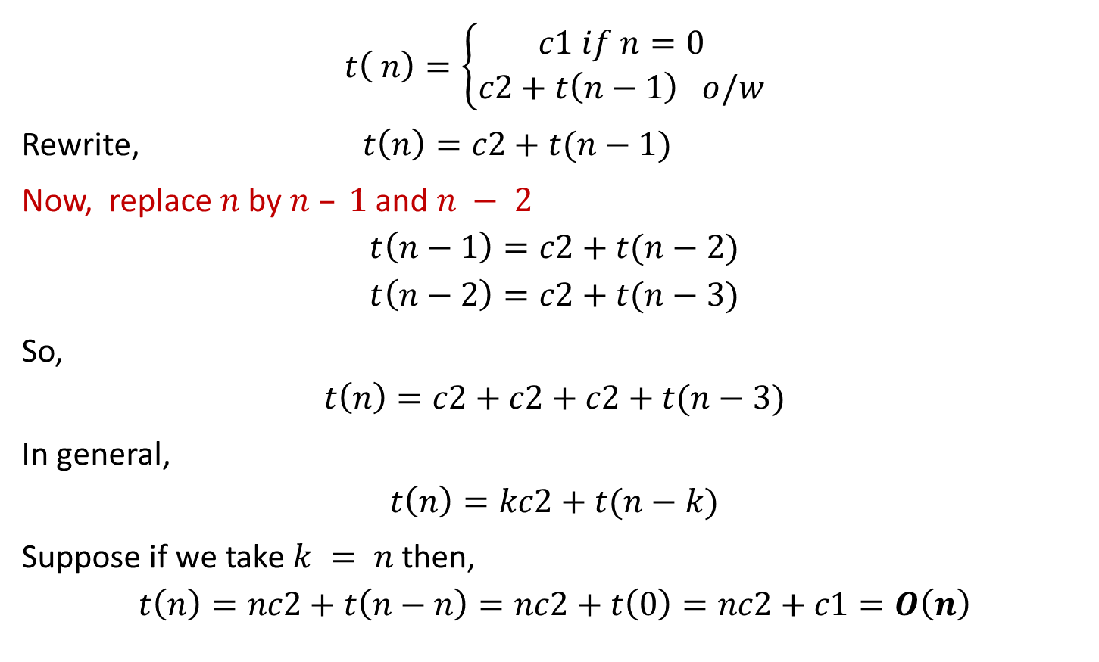
Exercise 1
$$t\left( n\right)=\left\{\begin{aligned}c1 if n=0 \\ c2+t\left(n−1\right) o/w\end{aligned}\right.$$
Rewrite, $t\left(n\right)=c2+t(n−1)$
Now, replace $n$ by $n – 1$and $n − 2$
$$t\left(n−1\right)=c2+t(n−2)$$
$$t\left(n−2\right)=c2+t(n−3)$$
So,
$$t\left(n\right)=c2+c2+c2+t(n−3)$$
In general,
$$t\left(n\right)=kc2+t(n−k)$$
Suppose if we take $k = n$then,
$$t\left(n\right)=nc2+t\left(n−n\right)=nc2+t\left(0\right)=nc2+c1=O\left(n\right)$$

Slide 8
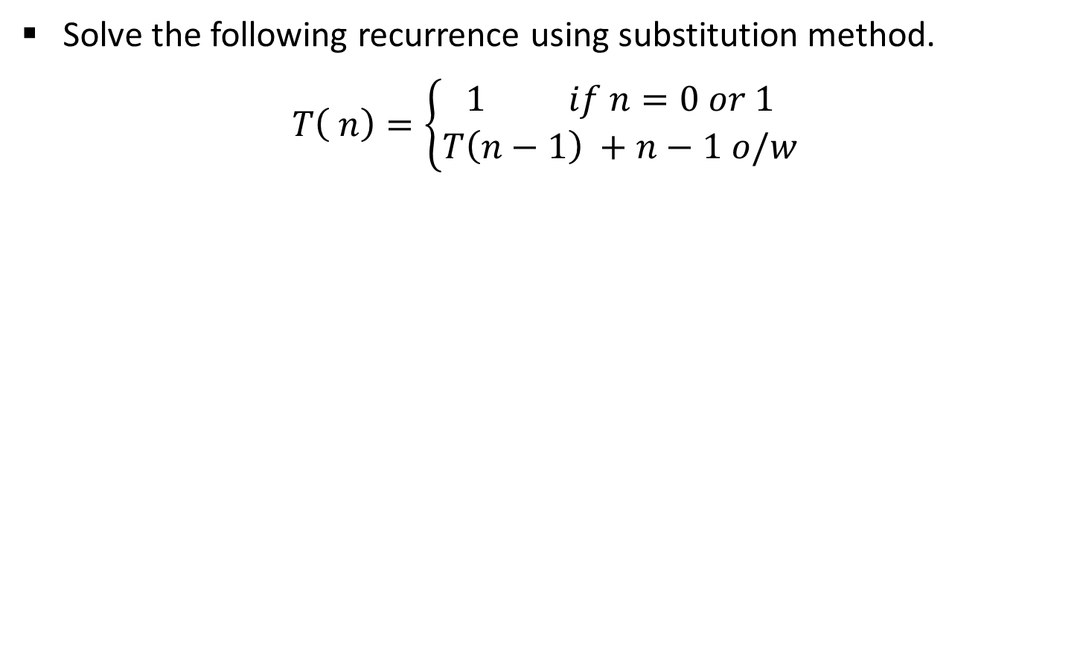
Exercise 2
Solve the following recurrence using substitution method.
$$T\left( n\right)=\left\{\begin{aligned}1 if n=0 or 1 \\ T\left(n−1\right) +n−1 o/w\end{aligned}\right.$$

Slide 9
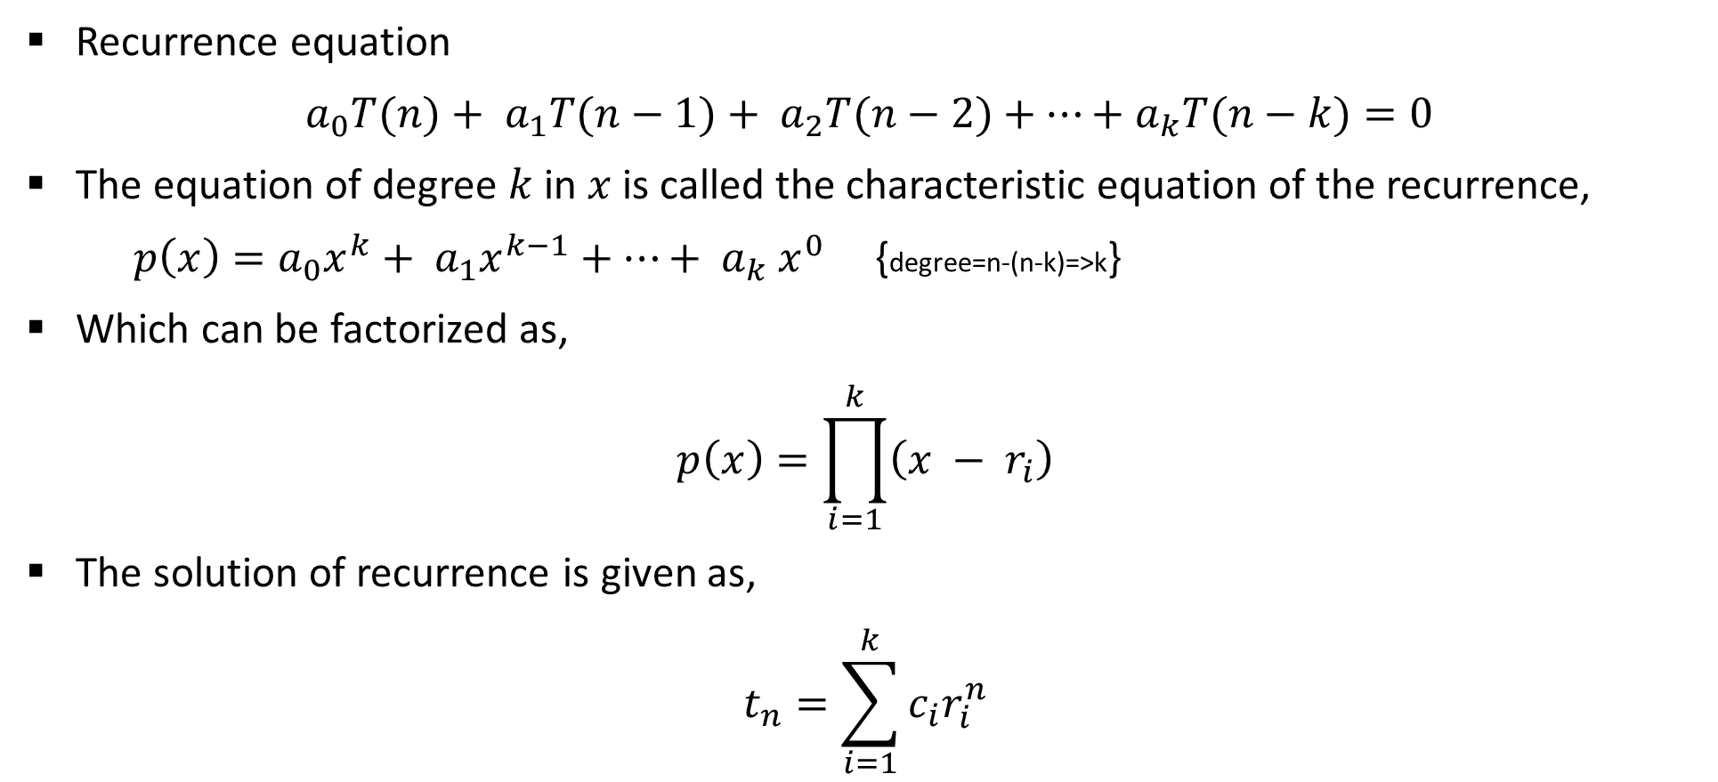
Homogeneous Recurrence
Recurrence equation
$a_{0}T(n)+ a_{1}T(n−1)+ a_{2}T(n−2)+⋯+a_{k}T(n−k)=0$
The equation of degree $k$in $x$ is called the characteristic equation of the recurrence,
$p\left(x\right)=a_{0}x^{k}+ a_{1}x^{k−1}+⋯+ a_{k} x^{0}$ {degree=n-(n-k)=>k}
Which can be factorized as,
$$p\left(x\right)=\prod_{i=1}^{k}{\left(x − r_{i}\right)}$$
The solution of recurrence is given as,
$$t_{n}=\sum_{i=1}^{k}{c_{i}r_{i}^{n}}$$

Slide 10
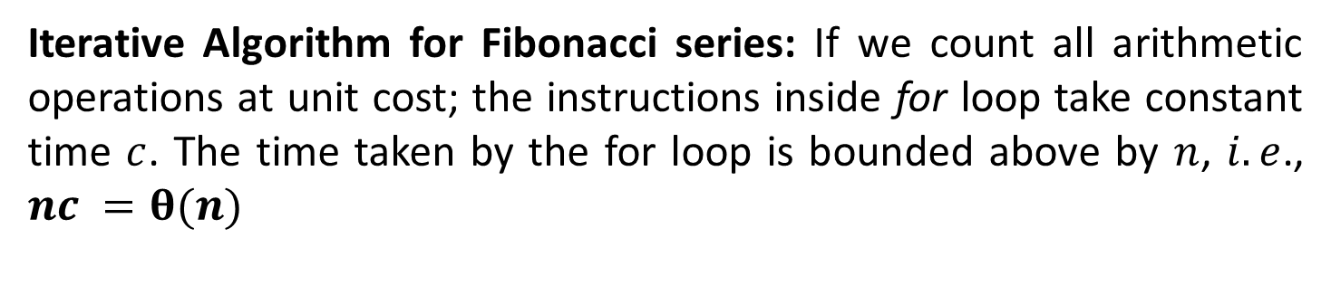
Analysis: Fibonacci series
Function fibiter(n)
i ← 1; j ← 0;
for k ← 1 to n do
j ← i + j;
i ← j – i;
return j
Iterative Algorithm for Fibonacci series: If we count all arithmetic operations at unit cost; the instructions inside for loop take constant time $c$. The time taken by the for loop is bounded above by $n$, $i.e$., $nc =θ(n)$

Slide 11
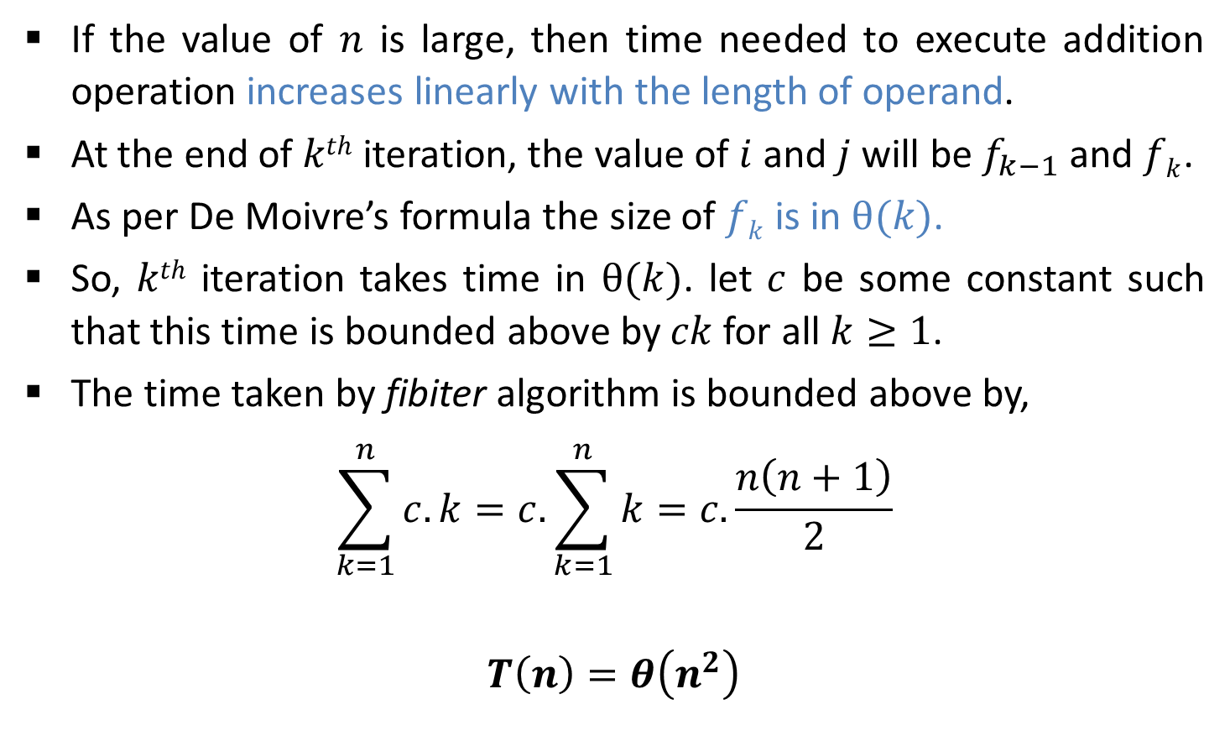
Analysis: Fibonacci series
If the value of $n$ is large, then time needed to execute addition operation increases linearly with the length of operand.
At the end of $kth$ iteration, the value of $i$ and $j$ will be $f_{k−1}$ and $fk$.
As per De Moivre’s formula the size of $fk$is in $θ(k)$.
So, $kth$ iteration takes time in $θ(k)$. let $c$ be some constant such that this time is bounded above by $ck$for all $k≥1$.
The time taken by fibiter algorithm is bounded above by,
$$\sum_{k=1}^{n}{c.k=c.\sum_{k=1}^{n}{k}}=c.\frac{n\left(n+1\right)}{2}$$
$$T\left(n\right)=θ\left(n^{2}\right)$$

Slide 12
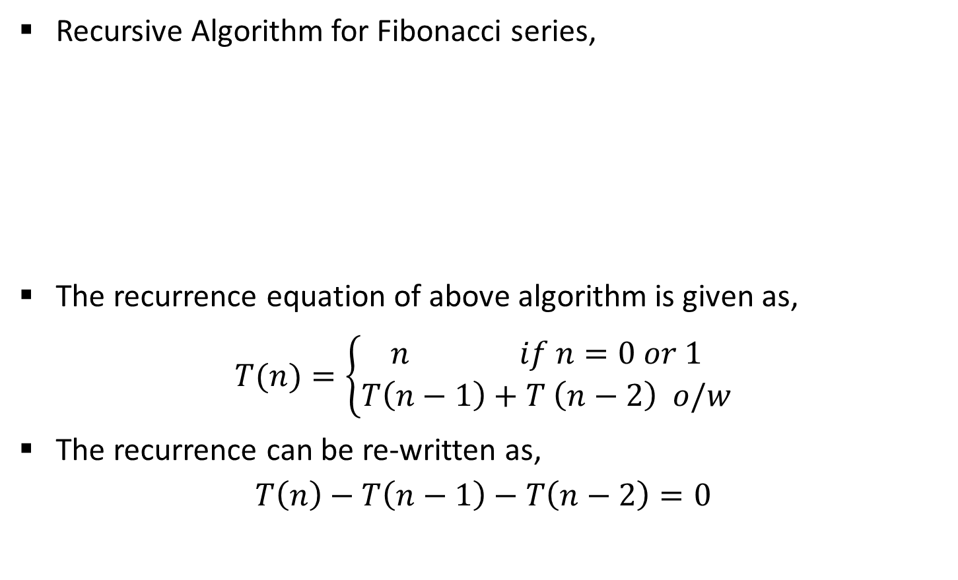
Analysis: Fibonacci series
Recursive Algorithm for Fibonacci series,
The recurrence equation of above algorithm is given as,
$$T(n)=\left\{\begin{aligned}n if n=0 or 1 \\ T\left(n−1\right)+T \left(n−2\right) o/w\end{aligned}\right.$$
The recurrence can be re-written as,
$$T\left(n\right)−T\left(n−1\right)−T\left(n−2\right)=0$$
Function fibrec(n)
if n < 2 then return n
else return fibrec (n – 1) + fibrec (n – 2)

Slide 13

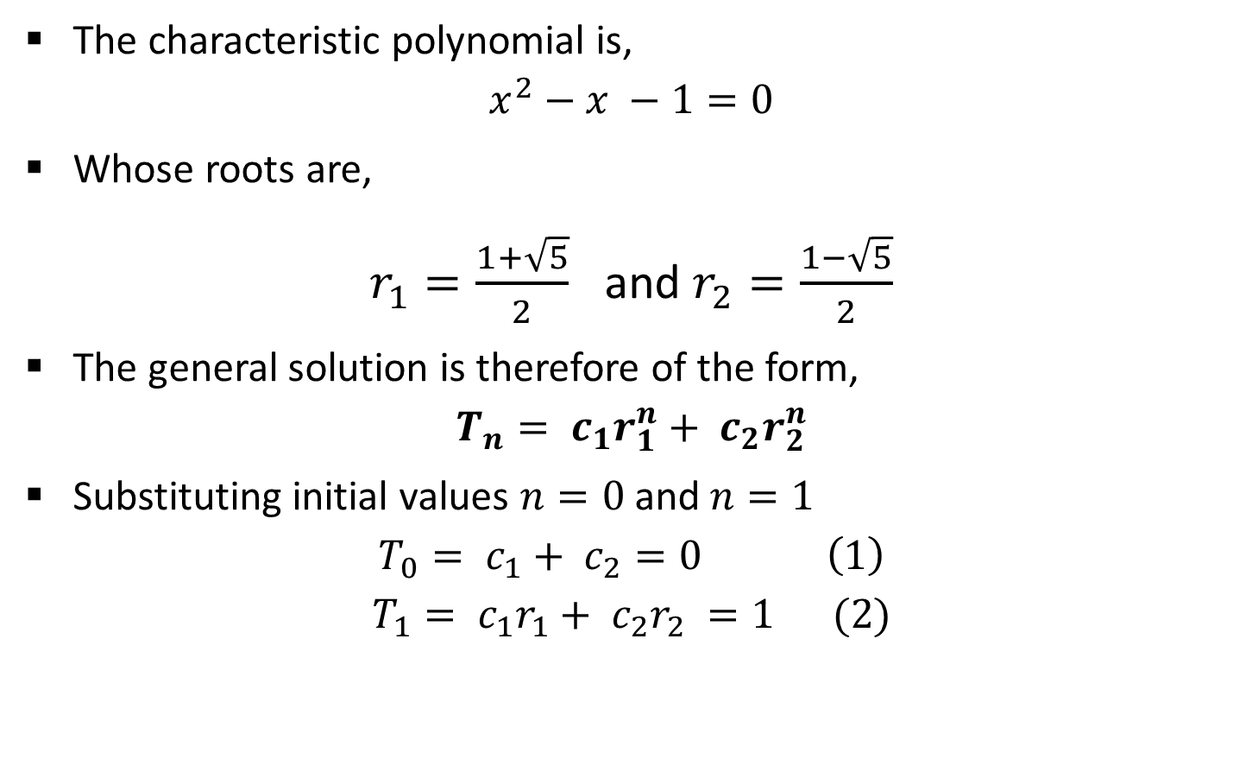

Analysis: Fibonacci series
The characteristic polynomial is,
$$x^{2}−x −1=0$$
Whose roots are,
$r_{1}=\frac{1+\sqrt{5}}{2}$ and $r_{2}=\frac{1−\sqrt{5}}{2}$
The general solution is therefore of the form,
$$T_{n}= c_{1}r_{1}^{n}+ c_{2}r_{2}^{n}$$
Substituting initial values $n=0$and $n=1$
$$T_{0}= c_{1}+ c_{2}=0 \left(1\right)$$
$$T_{1}= c_{1}r_{1}+ c_{2}r_{2} =1 (2)$$
$$x =\frac{−b±\sqrt{b^{2}−4ac}}{2a}$$
$$t_{n}=\sum_{i=1}^{k}{c_{i}r_{i}^{n}}$$

Slide 14
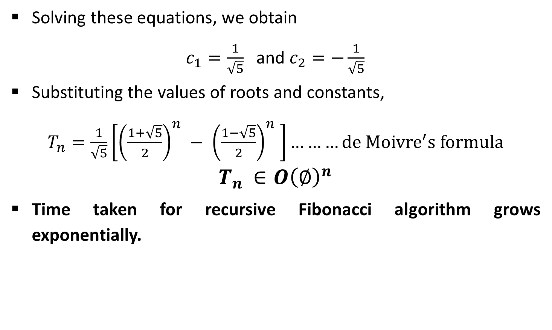
Analysis: Fibonacci series
Solving these equations, we obtain
$c_{1}=\frac{1}{\sqrt{5}}$ and $c_{2}=−\frac{1}{\sqrt{5}}$
Substituting the values of roots and constants,
$T_{n}=\frac{1}{\sqrt{5}}\left[{\left(\frac{1+\sqrt{5}}{2}\right)}^{n} − {\left(\frac{1−\sqrt{5}}{2}\right)}^{n} \right]………de {Moivre}^{′}s formula$
$$T_{n }∈O{\left(∅\right)}^{n}$$
Time taken for recursive Fibonacci algorithm grows exponentially.

Slide 15
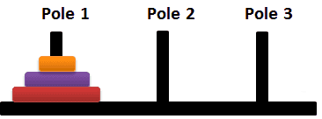



Analysis: Tower of Hanoi

Slide 16



Analysis: Tower of Hanoi

Slide 17
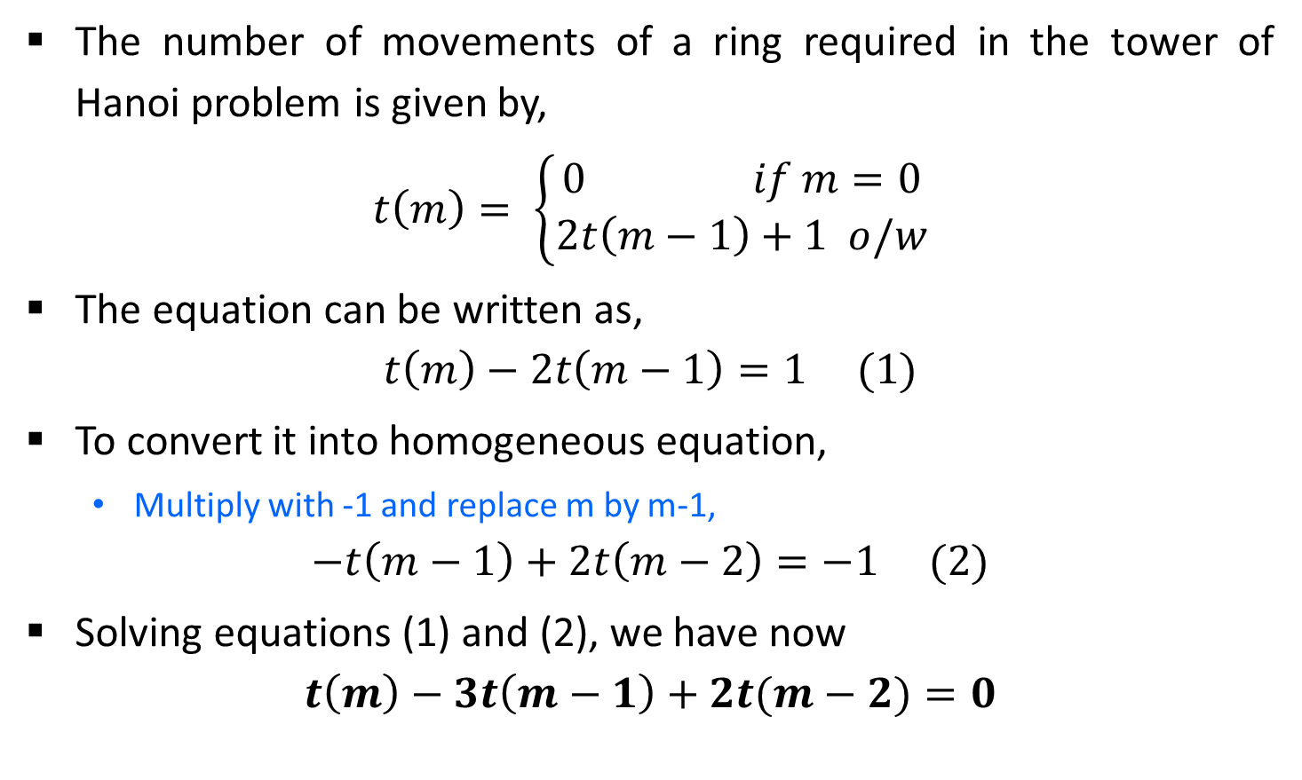
Analysis: Tower of Hanoi
The number of movements of a ring required in the tower of Hanoi problem is given by,
$$t\left(m\right)= \left\{\begin{aligned}0 if m=0 \\ 2t\left(m−1\right)+1 o/w\end{aligned}\right.$$
The equation can be written as,
$$t\left(m\right)−2t\left(m−1\right)=1 (1)$$
To convert it into homogeneous equation,
Multiply with -1 and replace m by m-1,
$$−t\left(m−1\right)+2t\left(m−2\right)=−1 (2)$$
Solving equations (1) and (2), we have now
$$t\left(m\right)−3t\left(m−1\right)+2t(m−2)=0$$
Inhomogeneous equation

Slide 18
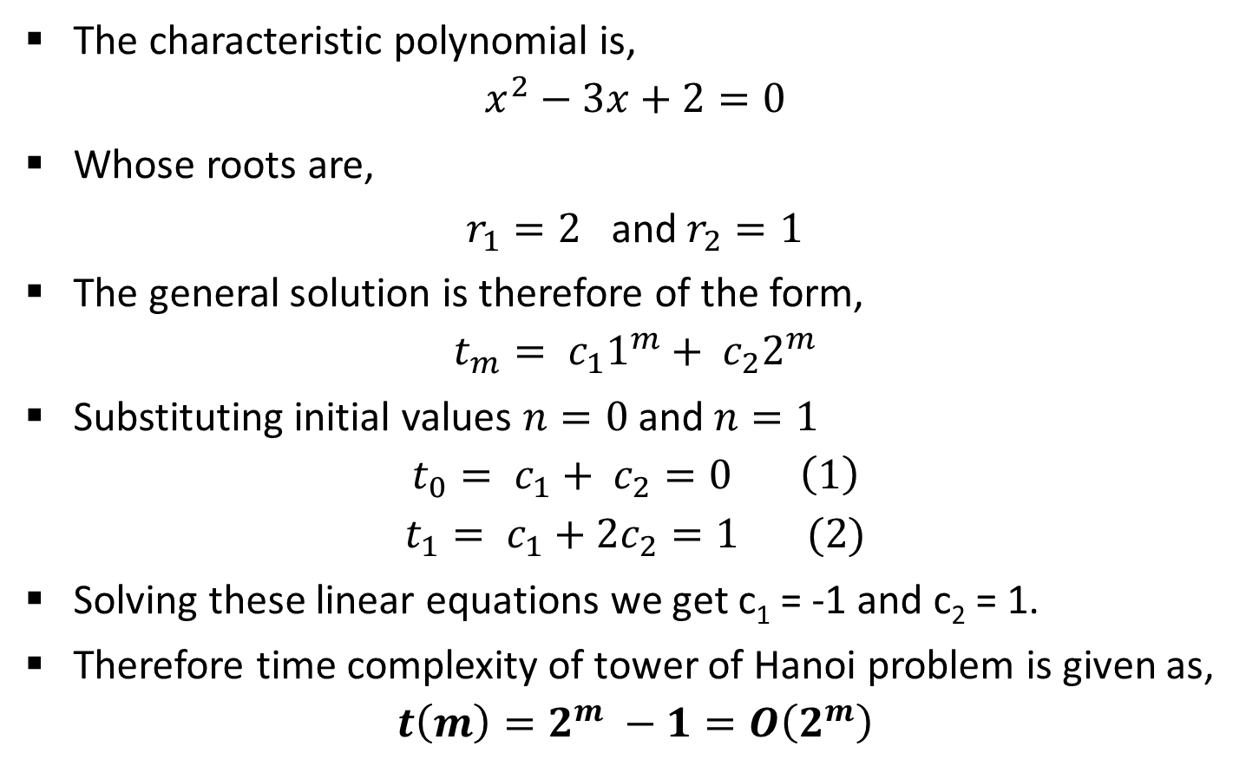
Analysis: Tower of Hanoi
The characteristic polynomial is,
$$x^{2}−3x+2=0$$
Whose roots are,
$r_{1}=2$ and $r_{2}=1$
The general solution is therefore of the form,
$$t_{m}= c_{1}1^{m}+ c_{2}2^{m}$$
Substituting initial values $n=0$and $n=1$
$$t_{0}= c_{1}+ c_{2}=0 \left(1\right)$$
$$t_{1}= c_{1}+2c_{2}=1 (2)$$
Solving these linear equations we get c₁ = -1 and c₂ = 1.
Therefore time complexity of tower of Hanoi problem is given as,
$$t\left(m\right)=2^{m} −1=O\left(2^{m}\right)$$

Slide 19
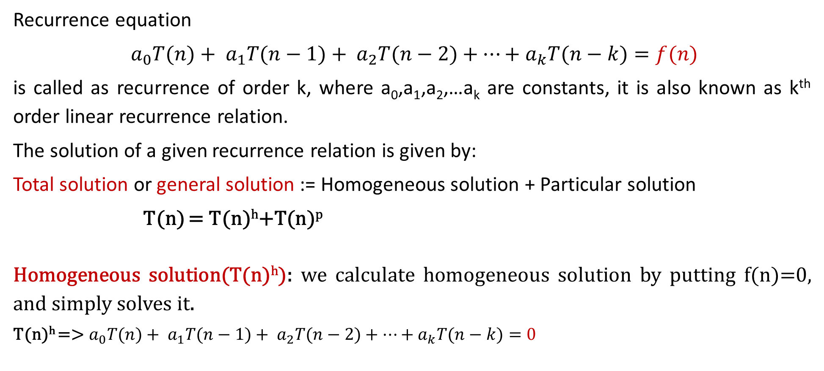
Non-homogeneous recurrence
Recurrence equation
$a_{0}T(n)+ a_{1}T(n−1)+ a_{2}T(n−2)+⋯+a_{k}T(n−k)=f(n)$
is called as recurrence of order k, where a₀,a₁,a₂,…a_{k} are constants, it is also known as k^{th} order linear recurrence relation.
The solution of a given recurrence relation is given by:
Total solution or general solution := Homogeneous solution + Particular solution
T(n) = T(n)^{h}+T(n)^{p}
Homogeneous solution(T(n)^{h}): we calculate homogeneous solution by putting f(n)=0, and simply solves it.
T(n)^{h} =>${ a}_{0}T(n)+ a_{1}T(n−1)+ a_{2}T(n−2)+⋯+a_{k}T(n−k)=0$

Slide 20
Particular solution(T(n)^{p}): it exist only when RHS of recurrence relation is non-zero. i.e. f(n)≠0.
If f(n)≠0 we consider three possibility:
Case1: f(n) is constant
Case2: f(n) is polynomial of degree n
Case3: f(n) is exponential

Slide 21
Particular solution(T(n)^{p})
Case1: f(n) is constant
find p by putting T(n)=p,
If fails, put T(n)=np
If fails, put T(n)=n²p…
T(n)-2T(n-1)+T(n-2)=1
=> To calculate Particular solution
=> put T(n)=P
=> P-2(P-1)+P-2=1
=> 0=1 fail
=> put T(n)=nP
=> nP-2(n-1)P+(n-2)P=1
=> 0=1 fail
=> put T(n)=n²P
=> n²P – 2(n-1)²P+(n-2)P=1
=> p=1/2
=> Now put the value of P in solution
T(n)^{p}=n²P=>n²/2

Slide 22
Particular solution(T(n)^{p})
Case2: f(n) is polynomial
T(n)=d₀+d₁n+d₂n²…d_{m}n^{m}
Find d0, d1, d2.. Y comparing the co-efficient
T(n)-8T(n-1) =14n+5
=> To calculate Particular solution
=> put T(n)= d₀+d₁n
=> d₀+d₁n – 8(d₀+d₁(n-1))=14n+5
=> -7d₀ – 7d₁n+8d₁=5 + 14n
=> By comparing the coefficient of n⁰, n¹ term
=> -7d₁=14 => d₁=-2
=> -7d₀+8d₁=5 =>d₀= -3
Now put the value of d₀ and d₁ to get the solution
T(n)^{p}=d₀+d₁n
T(n)^{p}= -3 + (-2)n

Slide 23
Particular solution(T(n)^{p})
Case3: f(n) is exponential function find d by putting T(n)=d*a^{n},
if homogeneous solution contains a term single a^{k} then T(n)= n(d*a^{n})
if contain two times then
T(n)= n²(d*a^{n})
T(n)-8T(n-1) =5 * 2^{n}
=> To calculate Particular solution
=> put T(n)= da^{n {a=2}}
=> d*2^{n} – 8*d2^{n-1}=5*2^{n}
=> d*2^{n} – 4*2¹*d2^{n-1}=5*2^{n}
=> d*2^{n} – 4*d2^{n}=5*2^{n}
=>2^{n}(d-4d)=5*2^{n}
=> By comparing the coefficient of 2^{n}
=> d=-5/3
Now put the value of d to get the solution
T(n)^{p}=da^{n}
T(n)^{p}= -3/2 * 2^{n}

Slide 24
Find the total solution: T(n)-8T(n-1) =14n+5
1. Homogeneous solution(T(n)^{h})
T(n)-8T(n-1)=0
characteristic equation
X-8=0 , roots=(8)
T(n)^{h} = c₁8^{n}
2. Particular solution(T(n)^{p})
=> put T(n)= d₀+d₁n
=> d₀+d₁n – 8(d₀+d₁(n-1))=14n+5
=> -7d₀ – 7d₁n+8d₁=5 + 14n
=> By comparing the coefficient of n⁰, n¹ term
=> -7d₁=14 => d₁=-2
=> -7d₀+8d₁=5 =>d₀= -3
Now put the value of d₀ and d₁ to get the solution
T(n)^{p}=d₀+d₁n
T(n)^{p}= -3 + (-2)n
Total solution(T(n))=(T(n)^{h}) + (T(n)^{h})
T(n) = c₁8^{n} -3 + (-2)^{n}

Slide 25
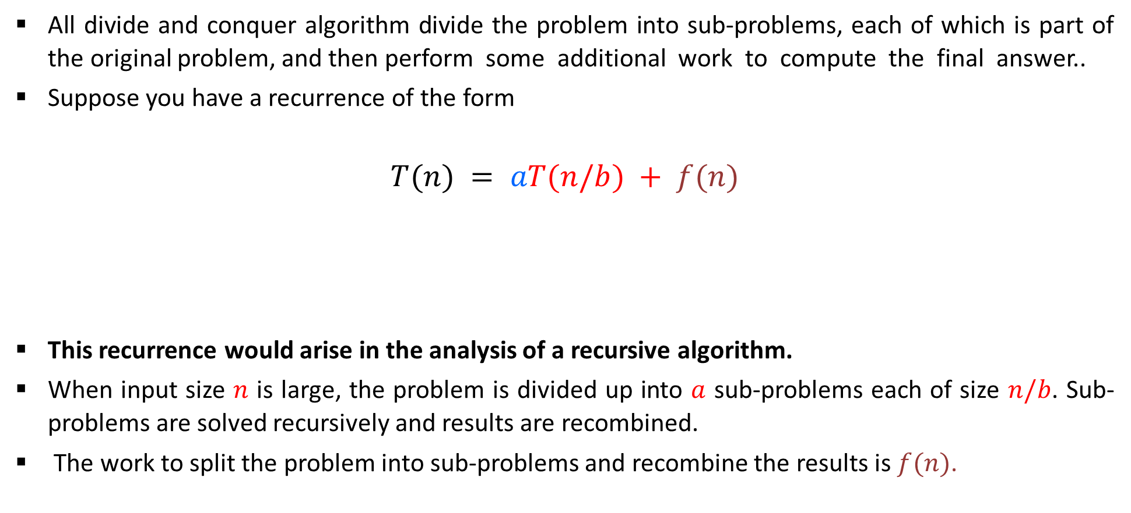
Master Method(for divide and conquer recurrence)
All divide and conquer algorithm divide the problem into sub-problems, each of which is part of the original problem, and then perform some additional work to compute the final answer..
Suppose you have a recurrence of the form
$$T(n) = aT(n/b) + f(n)$$
This recurrence would arise in the analysis of a recursive algorithm.
When input size $n$ is large, the problem is divided up into $a$ sub-problems each of size $n/b$. Sub-problems are solved recursively and results are recombined.
The work to split the problem into sub-problems and recombine the results is $f(n)$.
Time to divide & recombine
Number of sub-problems
Time required to solve a sub-problem

Slide 26

Master Method(for divide and conquer recurrence)
As an example, a merge sort algorithm operates on two sub-problems, each of which is half the size of the original, and then performs O(n) additional work for merging. This gives the running time equation:
T(n) = 2T (n/2) + O(n)
The following theorem can be used to determine the running time of divide and conquer algorithms. For a given program (algorithm), first we try to find the recurrence relation for the problem. If the recurrence is of the below form, then we can directly give the answer without fully solving it. If the recurrence is of the form
$$T(n) = aT(n/b) + θ(nklogpn)$$

Slide 27
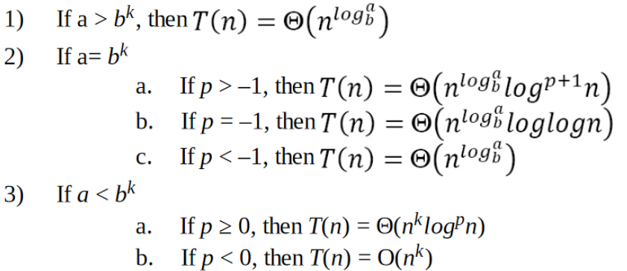

Master Method(for divide and conquer recurrence)
where a ≥ 1, b >1, k ≥ 0 and p is a real number, then:
$$T(n) = aT(n/b) + θ(nklogpn)$$

Slide 28

1.

Slide 29

2.

Slide 30

3.

Slide 31

4.

Slide 32

5.

Slide 33

6.

Slide 34

7.

Slide 35

8.

Slide 36

9.

Slide 37



10.
We can not apply master method in such cases

Slide 38

Master Method
Example 4: $T(n)=4T(n/2) + n2$
Example 5: $T(n)=4T(n/2) + n3$
Example 6: $T(n)=9T(n/3) + n$
Example 7: $T(n)=T(2n/3) + 1$
Example 8: $T\left(n\right)=7T\left(n/2\right)+n3$
Example 9: $T(n)=27T(n^{2}) +16n$

Slide 39
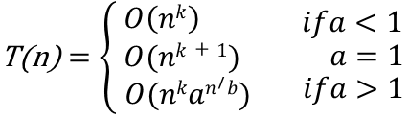

Master Theorem for Subtract and Conquer Recurrences
Let T(n) be a function defined on positive n, and having the property
T(n)$=\left\{\begin{aligned}c if n≤1 \\ aT\left(n−b\right)+f\left(n\right) if n>1\end{aligned}\right.$
for some constants c,a > 0,b ≥ 0,k ≥ 0, and function f(n). If f(n) is in O(n^{k} ), then

Slide 40
Recurrence Tree Method
Steps to solve recurrence relations using recursion tree method:
Step-01: Draw a recursion tree based on the given recurrence relation.
Step-02: Determine-
Cost of each level
Total number of levels in the recursion tree
Number of nodes in the last level
Cost of the last level
Step-03: Add cost of all the levels of the recursion tree and simplify the expression so obtained in terms of asymptotic notation

Slide 41

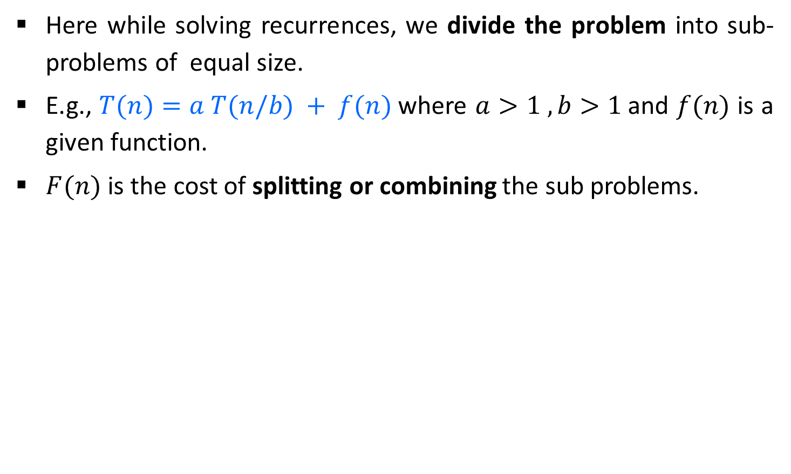
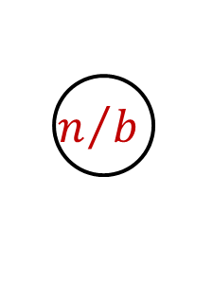
Recurrence Tree Method
Here while solving recurrences, we divide the problem into sub-problems of equal size.
E.g., $T(n)=a T(n/b) + f(n)$where $a>1 ,b>1$and $f(n)$ is a given function.
$F(n)$ is the cost of splitting or combining the sub problems.
$$n$$
$$n/b$$
$$n/b$$

Slide 42
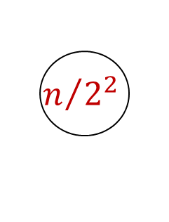


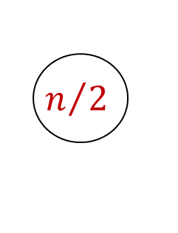

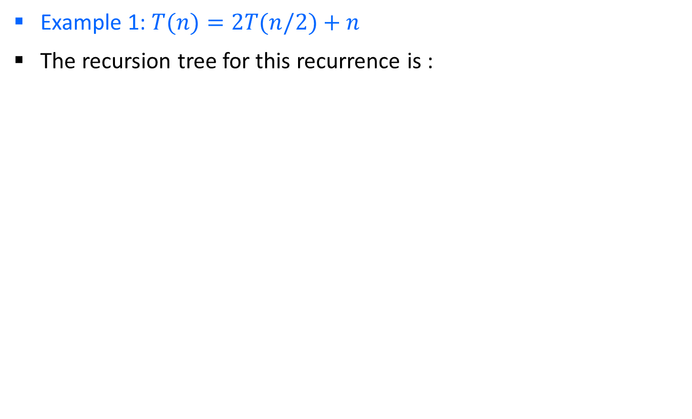

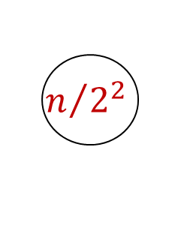




Recurrence Tree Method
Example 1: $T(n)=2T(n/2)+n$
The recursion tree for this recurrence is :
$$n$$
$$n/2$$
$$n/2$$
$$n$$
$$log2 n$$
$$n/{2^{2}}$$
$$n/{2^{2}}$$
$$n/{2^{2}}$$
$$n/{2^{2}}$$
$$n$$
$$1$$
$$1$$
$$1$$
$$1$$
$$1$$

Slide 43
Step-01:
Draw a recursion tree based on the given recurrence relation.
The given recurrence relation shows-
A problem of size n will get divided into 2 sub-problems of size n/2.
Then, each sub-problem of size n/2 will get divided into 2 sub-problems of size n/4 and so on.
At the bottom most layer, the size of sub-problems will reduce to 1.
The given recurrence relation shows-
The cost of dividing a problem of size n into its 2 sub-problems and then combining its solution is n.
The cost of dividing a problem of size n/2 into its 2 sub-problems and then combining its solution is n/2 and so on.
Step-02:
Determine cost of each level-
Cost of level-0 = n
Cost of level-1 = n/2 + n/2 = n
Cost of level-2 = n/4 + n/4 + n/4 + n/4 = n and so on.

Slide 44
Step-03:
Determine total number of levels in the recursion tree-
Size of sub-problem at level-0 = n/2⁰
Size of sub-problem at level-1 = n/2¹
Size of sub-problem at level-2 = n/2²
Continuing in similar manner, we have- Size of sub-problem at level-i = n/2^{i}
Suppose at level-x (last level), size of sub-problem becomes 1. Then- n / 2^{x} = 1
2^{x} = n
Taking log on both sides, we get- xlog₂2 = log₂n
x = log₂n
∴ Total number of levels in the recursion tree = log₂n + 1
Step-04:
Determine number of nodes in the last level-
Level-0 has 2⁰ nodes i.e. 1 node
Level-1 has 2¹ nodes i.e. 2 nodes
Level-2 has 2² nodes i.e. 4 nodes
Continuing in similar manner, we have- Level-log₂n, has 2^{log}₂^{n} nodes i.e. n nodes

Slide 45

Step-05: Determine cost of last level-
Cost of last level = n x T(1) = θ(n)
Step-06:
Add costs of all the levels of the recursion tree and simplify the expression so obtained in terms of asymptotic notation-
= n x log₂n + θ (n)
= nlog₂n + θ (n)
= θ (nlog₂n)

Slide 46
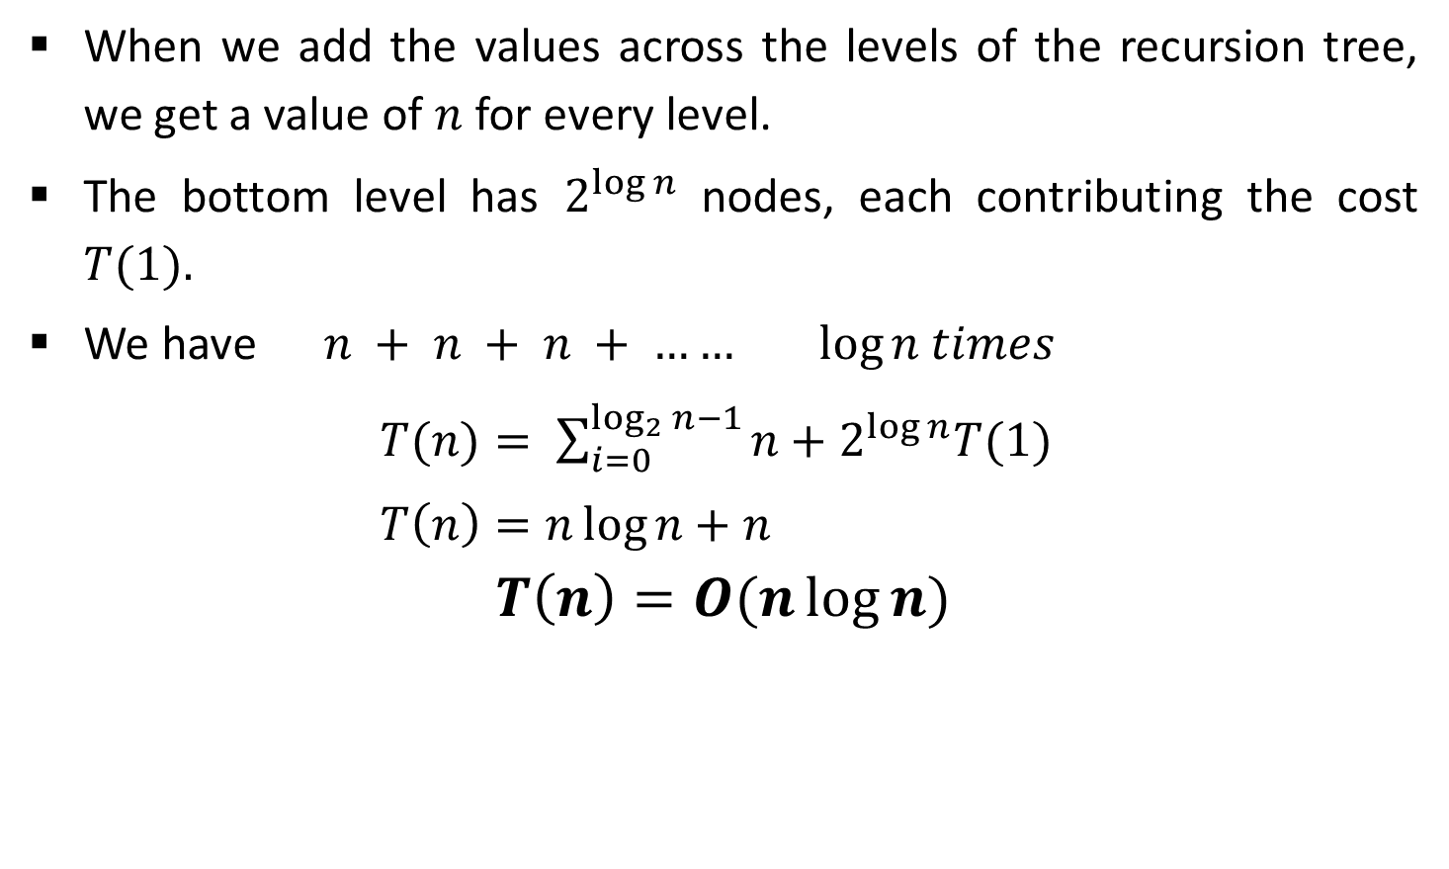
Recurrence Tree Method
When we add the values across the levels of the recursion tree, we get a value of $n$ for every level.
The bottom level has $2^{\log{n}}$ nodes, each contributing the cost $T(1).$
We have $n + n + n + …… log⁡n$ $times$
$T(n)= \sum_{i=0}^{\log_{2}{n}−1}{n+2^{\log{n}}T(1)}$
$T\left(n\right)=n\log{n}+n$
$$T\left(n\right)=O(n\log{n)}$$

Slide 47





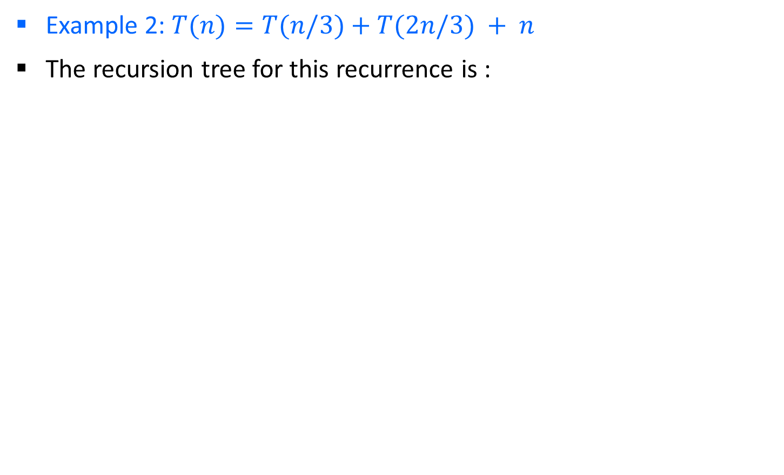






Recurrence Tree Method
Example 2: $T(n)=T(n/3)+T(2n/3) + n$
The recursion tree for this recurrence is :
$$n$$
$$n/3$$
$${2n}/3$$
$$n$$
$$log3 n$$
$$log3/2 n$$
$$\frac{1}{3}\frac{n}{3}$$
$$\frac{2}{3}\frac{n}{3}$$
$$\frac{1}{3}\frac{2n}{3}$$
$$\frac{2}{3}\frac{2n}{3}$$
$$n$$

Slide 48
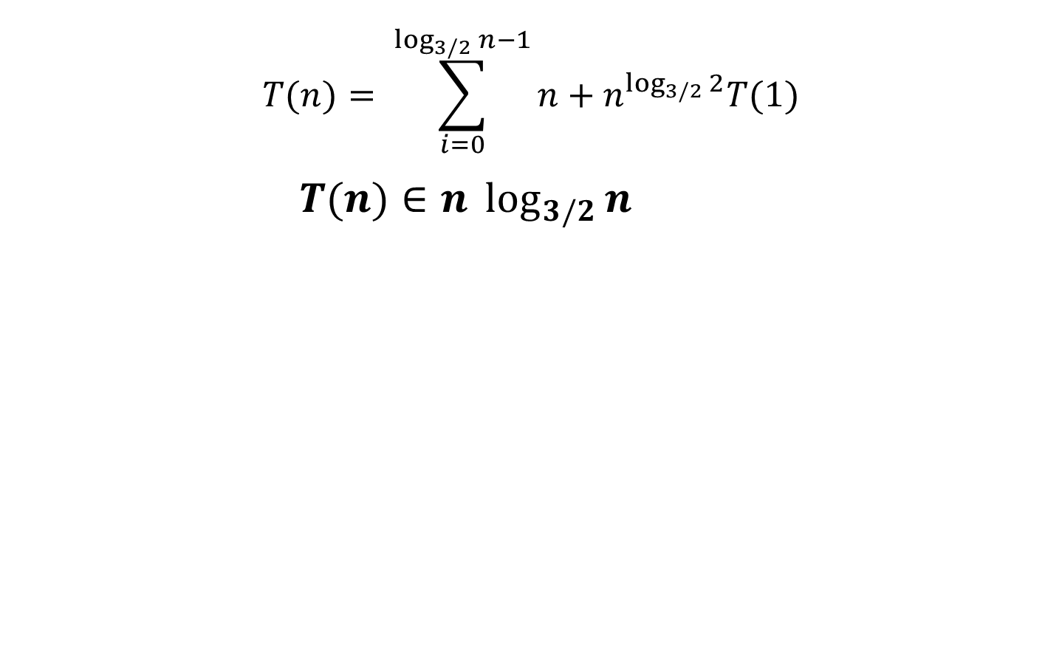
Recurrence Tree Method
$$T(n)= \sum_{i=0}^{\log_{3/2}{n}−1}{n+n^{\log_{3/2}{2}}T(1)}$$
$T(n)∈n \log_{3/2}{n}$

Slide 49
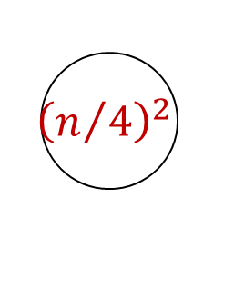
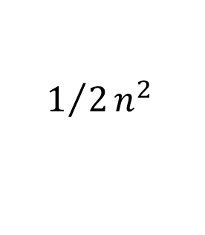



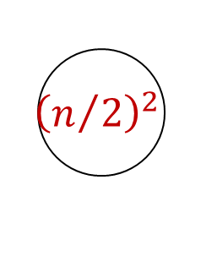
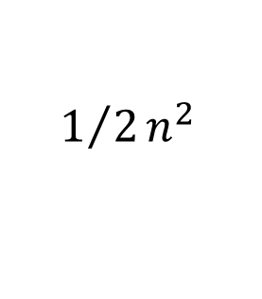
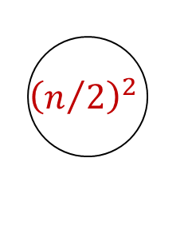
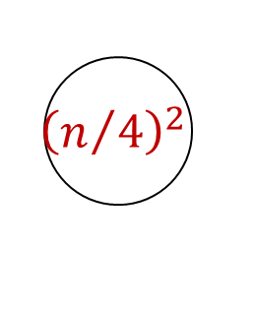


Recurrence Tree Method
Example 2: $T(n)=2T(n/2)+c.n2$
The recursion tree for this recurrence is :
$$n^{2}$$
$${\left(n/2\right)}^{2}$$
$${\left(n/2\right)}^{2}$$
$${1/2n}^{2}$$
$${\left(n/4\right)}^{2}$$
$${\left(n/4\right)}^{2}$$
$${\left(n/4\right)}^{2}$$
$${\left(n/4\right)}^{2}$$
$${1/2n}^{2}$$
$$O\left(n^{2}\right)$$
49

Slide 50
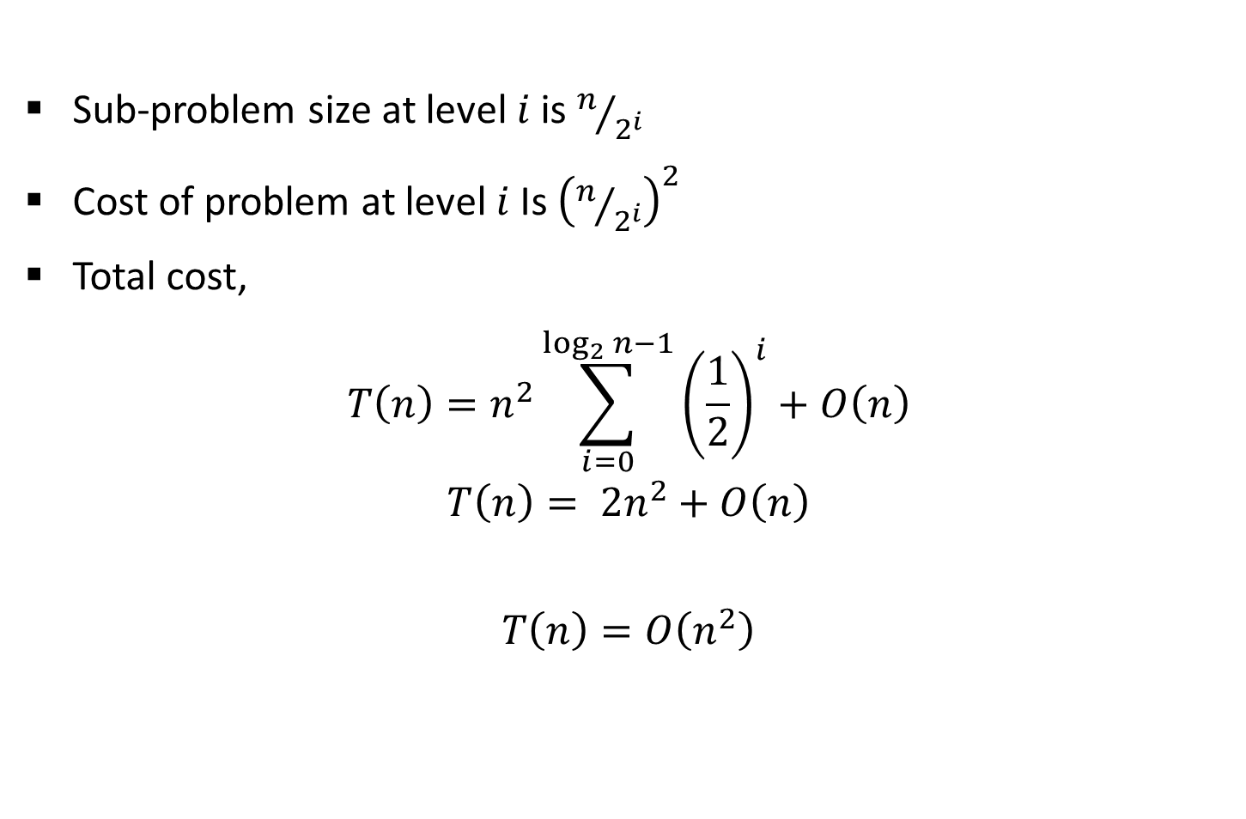
Recurrence Tree Method
Sub-problem size at level$i$is $n/{2^{i}}$
Cost of problem at level $i$Is ${\left(n/{2^{i}}\right)}^{2}$
Total cost,
$$T\left(n\right)=n^{2}\sum_{i=0}^{\log_{2}{n−1}}{{\left(\frac{1}{2}\right)}^{i}}+O\left(n\right)$$
$$T\left(n\right)= {2n}^{2}+O\left(n\right)$$
$$T\left(n\right)=O\left(n^{2}\right)$$

Slide 51

Recurrence Tree Method
Example 3: $T(n)= T(n/4)+T(3n/4)+c.n$
Example 4: $T(n)=3T(n/4)+c.n2$
Example 5: $T(n)=T(n/4)+T(n/2)+n2$
$\text{Example}\text{ 6:} T(n)=T(n/3)+T(2n/3) + n$

Slide 52
Method of Guessing and Confirming
“guess the answer; and then prove it correct by induction”
What if the given recurrence doesn’t seem to match with any of these (master theorem) methods? If we guess a solution and then try to verify our guess inductively, usually either the proof will succeed (in which case we are done), or the proof will fail (in which case the failure will help us refine our guess).

Slide 53


Example
Let’s start by trying to prove an upper bound T(n) < cnlogn:
The last inequality assumes only that 1 ≤ c. .logn. This is correct if n is sufficiently large and for any constant c, no matter how small. From the above proof, we can see that our guess is correct for the upper bound.

Slide 54
Change of variable-Method
There are many ways to solve a recurrence relation runtime. One way to do this is a method called “change of variable”.
Domain transformations can sometimes be used to substitute a function for the argument of the relation and make it easier to solve.
The idea is to select a function for S(m), when given T(n).

Slide 55

Example
m=logn
2^{m}=2^{log}2^{n}
2^{m}=n
2^{m/2}=2^{(log}2^{n/2)}
2^{m/2}=n^{1/2}
n=2^{m} --> T(2^{m})= S(m)
T(n)=2T$\sqrt{n}$ +logn
Let’s rewrite the equation by substituting m=log n, and then plug it back in to the recurrence to get the following:
T(2^{m})=2T(2^{m/2})+m
Now we will create a new function called ‘S’ that takes in a parameter ‘m’ such that S(m) = T(2^{m}).
Which means : S(m) = 2T(2^{m/2})+m.
If S(m) = T(2^{m}) then S(m-1) = T(2^{(m-1})) and S(m/2) = T(2^{(m/2)}), so we can rewrite our function to get the following:
S(m)=2S(m/2)+m
Using master theorem we can write the solution of recurrence ‘S’: O(mlogm).
This means that our original function ‘T’ belongs to O(log n * log ( log n) ), since we can simply replace ‘m’ with ‘log n’ because m=log n

Slide 56

Example
T(n)=$\sqrt{n}$T($\sqrt{n}$) +n
=>First substitute n = 2^{m}
T(2^{m})=2^{m/2}T(2^{m/2})+2^{m}
Now divide both side by 2^{m}
$\frac{\text{T}\text{(2}\text{m}\text{)} }{\text{2}\text{m}}$ =$\frac{\text{2}\text{m}\text{/2}\text{T}\text{(2}\text{m}\text{/2)}}{\text{2}\text{m}}$+$\frac{\text{2}\text{m}}{\text{2}\text{m}}$
$\frac{\text{T}\text{(2}\text{m}\text{)} }{\text{2}\text{m}}$ =$\frac{\text{2}\text{m}\text{/2}\text{T}\text{(2}\text{m}\text{/2)} }{\text{2}\text{m}}$+$1$ {$\frac{\text{T}\text{(2}\text{m}\text{)} }{\text{2}\text{m}}$ =$\frac{\text{T}\text{(2}\text{m}\text{/2)} }{\text{2}\text{m}\text{/2}}$+$1$}
=>second substitution S(m)=$\frac{\text{T}\text{(2}\text{m}\text{)} }{\text{2}\text{m}}$
S(m)=S(m/2)+1
By applying masters method we get : S(m)= log m
Now back substitution => $\frac{\text{T}\text{(2}\text{m}\text{)} }{\text{2}\text{m}}$=log m
T(2^{m})=2^{m} log m
Again back-substitute: T(n)=n log log n

Slide 57
T(n)=3T(n/2) +n
Substitute n=2^{m}
T(2^{m})=3T(2^{m}/2)+2^{m}
T(2^{m})=3T(2^{m-1})+2^{m}
Substitute S(m)=T(2^{m})
S(m)=3S(m-1)=2^{m}
S(m)-3S(m-1)=2^{m}
By characteristic equation
(X-3)(X-2)
Solution of S(m)=c₁3^{m}+c₂2^{m}
By back substitution
T(n)=c₁3^{logn}+c₂2^{logn}
=c₁n^{log3}+c₂n^{log2}

Slide 58
Range transformation
When we make a change of variable, we transform the domain of the recurrence.
Instead, it may be useful to transform the range to obtain a recurrence in a form that we know how to solve. Both transformations can sometimes be used together.
Consider the following recurrence, which defines T(n) when n is a power of 2.
T(n)=nT²(n/2)
The first step is a change of variable: n=2^{m}, S(m)=T(2^{m})
T(2^{m})= 2^{m} T²(2^{m}/2)=> T²(2^{m-1})
S(m)=2^{m} S²(m-1)
At first glance, none of the techniques we have seen applies to this recurrence since it is not linear; To transform the range, we create yet another recurrence by using U(m) to denote log S(m).

Slide 59
S(m)=2^{m} S²(m-1)
Substitute U(m)=log(S(m))
=log(2^{m} S²(m-1))
=log2^{m} + log S²(m-1)
=m+2log S(m-1)
=m+2U(m-1)
U(m)= m+2U(m-1)
U(m)-2U(m-1)=m
Solve this by applying Characteristic equation:

Slide 60
Divide & Conquer (D&C) Technique
Many useful algorithms are recursive in structure: to solve a given problem, they call themselves recursively one or more times.
These algorithms typically follow a divide-and-conquer approach:
The divide-and-conquer approach involves three steps at each level of the recursion:
Divide: Break the problem into several sub problems that are similar to the original problem but smaller in size.
Conquer: Solve the sub problems recursively. If the sub problem sizes are small enough, just solve the sub problems in a straightforward manner.
Combine: Combine these solutions to create a solution to the original problem.

Slide 61



D&C: Running Time Analysis
The running-time analysis of such divide-and-conquer (D&C) algorithms is almost automatic.
Let $g(n)$ be the time required by D&C on instances of size $n$.
The total time $t(n)$ taken by this divide-and-conquer algorithm is given by recurrence equation,
$$t\left(n\right)=a∗t\left(n/b\right)+g\left(n\right)$$
The solution of equation is given as,
$$t\left(n\right)=\left\{\begin{aligned}θ\left(n^{k}\right) if a< b^{k} \\ θ\left(n^{k}logn\right) if a= b^{k} \\ θ\left(n^{\log_{b}a}\right) if a >b^{k}\end{aligned}\right.$$
$$T(n) = aT(n/b) + f(n)$$
$k$ is the power of $n$ in $g(n)$

Slide 62
Binary Search

Slide 63

Binary Search
Binary Search is an extremely well-known instance of divide-and-conquer approach.
Let $T[1 . . . n]$be an array of increasing sorted order; that is $T [i]≤T[j]$ whenever $1≤i≤j≤n$.
Let $x$ be some number. The problem consists of finding $x$ in the array $T$ if it is there.
If $x$ is not in the array, then we want to find the position where it might be inserted.

Slide 64

Binary Search - Example
Input: sorted array of integer values. $x=7$.
[ 0 ]
[ 1 ]
[ 2 ]
[ 3 ]
[ 4 ]
[ 5 ]
[ 6 ]
3
6
7
11
32
33
53
[ 0 ]
[ 1 ]
[ 2 ]
[ 3 ]
[ 4 ]
[ 5 ]
[ 6 ]
3
6
7
11
32
33
53
Find approximate midpoint

Slide 65

Binary Search - Example
[ 0 ]
[ 1 ]
[ 2 ]
[ 3 ]
[ 4 ]
[ 5 ]
[ 6 ]
$$x=7$$
3
6
7
11
32
33
53
Is 7 = midpoint key? NO.
Is 7 < midpoint value? YES.
[ 0 ]
[ 1 ]
[ 2 ]
[ 3 ]
[ 4 ]
[ 5 ]
[ 6 ]
3
6
7
11
32
33
53
Search for the target in the area before midpoint.

Slide 66



Binary Search - Example
[ 0 ]
[ 1 ]
[ 2 ]
[ 3 ]
[ 4 ]
[ 5 ]
[ 6 ]
$$x=7$$
3
6
7
11
32
33
53
Find approximate midpoint
[ 0 ]
[ 1 ]
[ 2 ]
[ 3 ]
[ 4 ]
[ 5 ]
[ 6 ]
3
6
7
11
32
33
53
$x$ > value of midpoint? YES.
$x$ = value of midpoint? NO.
$x$ < value of midpoint? NO.

Slide 67


Binary Search - Example
[ 0 ]
[ 1 ]
[ 2 ]
[ 3 ]
[ 4 ]
[ 5 ]
[ 6 ]
$$x=7$$
3
6
7
11
32
33
53
Search for the $x$ in the area after midpoint.
[ 0 ]
[ 1 ]
[ 2 ]
[ 3 ]
[ 4 ]
[ 5 ]
[ 6 ]
3
6
7
11
32
33
53
Find approximate midpoint.
Is $x$ = midpoint value? YES.

Slide 68
Binary Search – Iterative Algorithm
Algorithm: BinarySearch(T[1,…,n], x)
if x > T[n] then return n+1
i ← 1;
j ← n;
while i < j do
k ← (i + j ) ÷ 2
if x ≤ T [k] then j ← k
else i ← k + 1
return i A[j] ← A[j+1] A[j+1] ← temp
n=7
i
3
6
7
k
11
32
33
j
53
j

Slide 69
Binary Search – Recursive Algorithm
BinarySearch(arr, item, beg, end)
if beg<=end
midIndex = (beg + end) / 2
if item == arr[midIndex]
return midIndex
else if item < arr[midIndex]
return binarySearch(arr, item, midIndex + 1, end)
else
return binarySearch(arr, item, beg, midIndex – 1)
return -1

Slide 70


Binary Search - Analysis
Let $t(n)$ be the time required for a call on binrec$( T[i,…,j], x ),$where $n = j – i + 1$is the number of elements still under consideration in the search.
The recurrence equation is given as,
$$t(n)=t(n/2)+θ(1)$$
Comparing this to the general template for divide and conquer algorithm, $a=1, b=2 and c=0.$
$∴t(n)∈θ(log⁡n)$
The complexity of binary search is $θ(log⁡n)$
$$T(n)=aT(n/b)+f(n)$$

Slide 71

Binary Search – Examples
Demonstrate binary search algorithm and find the element $x=12$in the following array. [3 / 4]
$$2, 5, 8, 12, 16, 23, 38, 56, 72, 91$$
Explain binary search algorithm and find the element $x=31$in the following array. [7]
$$10, 15, 18, 26, 27, 31, 38, 45, 59$$
Let $T[1..n]$ be a sorted array of distinct integers. Give an algorithm that can find an index $i$ such that $1 ≤ i ≤ n$ and $T[i] = i,$ provided such an index exists. Prove that your algorithm takes time in $O(logn)$in the worst case. (**)

Slide 72
Multiplying Large Integers

Slide 73










Multiplying Large Integers Problem
Multiplying two 𝑛 digit large integers using divide and conquer method.
Example: Multiplication of $981$ by $1234$.
Convert both the numbers into same length nos. and split each operand into two parts:
We can write as,
$$0981$$
$$1234$$
$$w=09$$
$$x=81$$
$$y=12$$
$$z=34$$
$$102w+x$$
$$=102\left(09\right)+81$$
$$=900+81$$
=$981$
$$0981=102w + x$$
$$1234=102y + z$$

Slide 74




Multiplying Large Integers Problem
Now, the required product can be computed as,
$$0981×1234=\left({10}^{2}w+x\right)×\left({10}^{2}y+z\right)$$
$$={10}^{4}w∙y+{10}^{2}\left(w∙z+x∙y\right)+x∙z$$
$$= 1080000 + 127800 + 2754$$
$$= 1210554$$
The above procedure still needs four half-size multiplications:
$$\left(i\right)w∙y \left(ii)w∙z \left(iii\right)x∙y (iv\right)x∙z$$
The computation of $(w∙z+x∙y)$ can be done as,
Only one multiplication is required instead of two.
$$w=09$$
$$x=81$$
$$y=12$$
$$z=34$$
$$r=\left(w+x\right)×\left(y+z\right)$$
$$=w∙y+\left(w∙z+x∙y\right)+x∙z$$
Additional terms

Slide 75




Multiplying Large Integers Problem
Now we can compute the required product as follows:
$$w=09$$
$$x=81$$
$$y=12$$
$$z=34$$
$$p = w∙y = 09∙12 =108$$
$$q =x∙z =81∙34 =2754$$
$$r=\left(w+x\right)×\left(y+z\right)=90∙46=4140$$
$$r=\left(w+x\right)×\left(y+z\right)$$
$$=w∙y+\left(w∙z+x∙y\right)+x∙z$$
$${10}^{4}w∙y+{10}^{2}\left(w∙z+x∙y\right)+x∙z$$
$$981×1234 = 104p + {10}^{2} (r − p − q) + q$$
$$= 1080000 + 127800 + 2754$$
$$= 1210554.$$

Slide 76

for Binary Number
a=
b=
a_{L} | a_{R}
b_{L} | b_{R}
$$w=aL$$
$$x=aR$$
$$y=bL$$
$$z=bR$$
$$p = w∙y =aL∗bL$$
$$q =x∙z =aR∗bR$$
$$r=\left(w+x\right)×\left(y+z\right)=\left(aL+aR\right)×\left(bL+bR\right)$$
$$r=\left(w+x\right)×\left(y+z\right)$$
$$=w∙y+\left(w∙z+x∙y\right)+x∙z$$
$${a∙b=2}^{n}aL∙bL+2^{n/2}\left(aL∙bR+aR∙bL\right)+aR∙bR$$
$$a×b =2np + 2^{n/2} (r − p − q) + q$$

Slide 77

Algorithm
Multiply(a, b, n)
if n = 1 return a*b
a_{L}= The left half of a
a_{R}= The right half of a
b_{L}= The left half of b
b_{R}= The right half of b
p= Multiply(a_{L}, a_{R}, n/2) //recursive call
q= Multiply(b_{L}, b_{R}, n/2) //recursive call
r= ($\left(aL+aR\right),\left(bL+bR\right)$, n/2) //recursive call
return $2np + 2^{n/2} (r − p − q) + q$ //
time taken by p, q, and r are n/2, while $2np$appending n zeros to right will be proportional to n, addition and subtraction are proportional to n.

Slide 78

Analysis of Time Complexity
$981 × 1234$can be reduced to three multiplications of two-figure numbers $(09∙12, 81∙34 and 90∙46)$together with a certain number of shifts, additions and subtractions.
Reducing four multiplications to three will enable us to cut 25% of the computing time required for large multiplications.
We obtain an algorithm that can multiply two $n$-figure numbers in a time,
$T(n)= 3t (n/2) + g(n),$ vs $T(n)=4t (n/2) + g(n),$
Solving it gives,
$$T\left(n\right)∈θ\left(n^{log3}\right)=n1.59$$

Slide 79







Multiplying Large Integers Problem
Example: Multiply $8114$ with $7622$ using divide & conquer method.
Solution using D&C
Step 1:
$$w=81$$
$$x=14$$
$$y=76$$
$$z=22$$
Step 2:
Calculate $p, q$and $r$
$$p=w∙y=81∙76=6156$$
$$q=x∙z=14∙22=308$$
$r=(w+x)∙(y+z)=95∙98=931$0
$$8114×7622=104p+{10}^{2} (r−p−q)+q$$
$$= 61560000+284600+308$$
$$=61844908$$

Slide 80
Merge Sort

Slide 81
Merge Sort - Example
Unsorted Array
724 | 521 | 2 | 98 | 529 | 31 | 189 | 451
1 | 2 | 3 | 4 | 5 | 6 | 7 | 8
Step 1: Split the selected array
1
2
3
4
5
6
7
8
724
521
2
98
529
31
189
451
724
521
2
98
529
31
189
451
1
2
3
4
1
2
3
4

Slide 82
Merge Sort - Example
Select the left subarray and Split
Select the right subarray and Split
1
2
3
4
1
2
3
4
724
521
2
98
529
31
189
451
1
2
1
2
Split
1
2
1
2
724
521
2
98
529
31
189
451
1
1
1
1
1
1
1
1
724
521
2
98
529
31
189
451
521
724
2
98
31
529
189
451
Merge
2
98
521
724
31
189
451
529
2
31
98
189
451
521
529
724

Slide 83
Merge Sort – Example (HW)
Sort given numbers into descending order using merge sort.
38, 27, 43, 3, 9, 82, 10, 67, 71, 54, 97

Slide 84
Merge Sort - Algorithm
Merge Sort is an example of divide and conquer algorithm.
It is based on the idea of breaking down a list into several sub-lists until each sub list consists of a single element.
Merging those sub lists in a manner that results into a sorted list.
Procedure
Divide the unsorted list into N sub lists, each containing 1 element
Take adjacent pairs of two singleton lists and merge them to form a list of 2 elements. N will now convert into N/2 lists of size 2
Repeat the process till a single sorted list of obtained

Slide 85
Merge Sort - Algorithm
merge(U[p..q],V[q+1..r],T[])
i ← 1;
j ← 1;
U[q+1], V[r+1] ← ∞;
for k ← 1 to q + r do
if U[i] < V[j]
T[k] ← U[i];
i ← i + 1;
else
T[k] ← V[j];
j ← j + 1;] A[j+1← temp
MergeSort(A, p, r):
if p > r
return
q = (p+r)/2
mergeSort(A, p, q)
mergeSort(A, q+1, r)
merge(A, p, q, r)

Slide 86



Merge Sort - Analysis
Let $T(n)$ be the time taken by this algorithm to sort an array of $n$ elements.
Separating $T$ into $U \& V$takes linear time; $merge(U, V, T)$also takes linear time.
$T(n)=T(n/2)+ T(n/2)+g(n)$where $g(n)∈θ(n)$.
$$T(n)=2t(n/2)+ θ(n)$$
Applying the general case, $a=2, b=2, k=1$
Since $a=bk$the second case applies so, $t(n)∈θ(nlogn).$
Time complexity of merge sort is $θ(nlogn).$
$$t\left(n\right)=at\left(n/b\right)+g\left(n\right)$$
$$t\left(n\right)=\left\{\begin{aligned}θ\left(n^{k}\right) if a < b^{k} \\ θ\left(n^{k}logn\right) if a= b^{k} \\ θ\left(n^{\log_{b}a}\right) if a >b^{k}\end{aligned}\right.$$

Slide 87
Quick Sort

Slide 88
Quick Sort – Example(Inplace)
Quick sort chooses the first element as a pivot element, a lower bound is the first index and an upper bound is the last index.
The array is then partitioned on either side of the pivot.
Elements are moved so that, those greater than the pivot are shifted to its right whereas the others are shifted to its left.
Each Partition is internally sorted recursively.
Pivot
Element
0
1
2
3
4
5
6
7
6
7
42
23
74
11
65
58
94
36
99
87
LB
UB

Slide 89
Quick Sort - Example
Procedure pivot(T[i,…,j]; var l)
p ← T[i]
k ← i; l ← j+1
Repeat
k ← k+1 until T[k] > p or k ≥ j
Repeat
l ← l-1 until T[l] ≤ p
While k < l do
Swap T[k] and T[l]
Repeat k ← k+1 until
T[k] > p
Repeat l ← l-1 until
T[l] ≤ p
Swap T[i] and T[l]
0
1
2
3
4
5
6
7
8
9
42
23
74
11
65
58
94
36
99
87
k
l
Swap
42
23
74
36
11
65
58
94
36
74
99
87
k
l
Swap
42
11
23
36
11
42
65
58
94
74
99
87
k
l
LB = 0, UB = 9
p = 42
k =
0
l =
10

Slide 90
Quick Sort - Example
Procedure pivot(T[i,…,j]; var l)
p ← T[i]
k ← i; l ← j+1
Repeat
k ← k+1 until T[k] > p or k ≥ j
Repeat
l ← l-1 until T[l] ≤ p
While k < l do
Swap T[k] and T[l]
Repeat k ← k+1 until
T[k] > p
Repeat l ← l-1 until
T[l] ≤ p
Swap T[i] and T[l]
LB
UB
0
1
2
3
4
5
6
7
8
9
11
23
36
42
65
58
94
74
99
87
11
11
23
36
k
l
LB
UB
11
23
36
42
65
58
94
74
99
87
23
23
36
k
l
11
23
36
36
42
65
58
94
74
99
87

Slide 91
Quick Sort - Example
LB
UB
Procedure pivot(T[i,…,j]; var l)
p ← T[i]
k ← i; l ← j+1
Repeat
k ← k+1 until T[k] > p or k ≥ j
Repeat
l ← l-1 until T[l] ≤ p
While k < l do
Swap T[k] and T[l]
Repeat k ← k+1 until
T[k] > p
Repeat l ← l-1 until
T[l] ≤ p
Swap T[i] and T[l]
4
5
6
7
8
9
11
23
36
42
65
58
94
72
99
87
Swap
65
65
58
58
65
94
72
99
87
k
l
65
65
58
58
65
94
72
99
87
LB
UB
11
23
36
42
65
65
58
65
94
72
99
87

Slide 92
Quick Sort - Example
LB
UB
Procedure pivot(T[i,…,j]; var l)
p ← T[i]
k ← i; l ← j+1
Repeat
k ← k+1 until T[k] > p or k ≥ j
Repeat
l ← l-1 until T[l] ≤ p
While k < l do
Swap T[k] and T[l]
Repeat k ← k+1 until
T[k] > p
Repeat l ← l-1 until
T[l] ≤ p
Swap T[i] and T[l]
Swap
94
94
72
99
87
87
99
k
l
Swap
94
94
87
72
87
94
99
k
l
LB
UB
Swap
87
87
72
72
87
94
99
k
l
11
23
36
42
58
65
72
72
87
94
99
99

Slide 93
Quick Sort - Examples
Sort the following array in ascending order using quick sort algorithm.
5, 3, 8, 9, 1, 7, 0, 2, 6, 4
3, 1, 4, 1, 5, 9, 2, 6, 5, 3, 5, 8, 9 (HW)
9, 7, 5, 11, 12, 2, 14, 3, 10, 6 (HW)

Slide 94


Quick Sort - Algorithm

Slide 95

Quick Sort - Analysis
Worst Case
Running time depends on which element is chosen as key or pivot element.
The worst case behavior for quick sort occurs when the array is partitioned into one sub-array with $n−1$ elements and the other with $0$ element.
In this case, the recurrence will be,
$$T(n)=T(n−1)+T(0)+θ(n)$$
$$T(n)=T(n−1)+ θ(n)$$
$$T(n)= θ(n2)$$
$θ\left(n\right):cost of partitioning at each level, which is i+j times we are moving, in this case i=n−1 and j=1$
When does the worst case appear?: when the element are sorted.

Slide 96

Quick Sort - Analysis
Best Case
Occurs when partition produces sub-problems each of size n/2.
Recurrence equation:
$$T(n)=2T(n/2)+ θ(n)$$
$$l = 2, b = 2, k = 1, so l = bk$$
$$T(n)= θ(nlogn)$$
Average Case
Average case running time is much closer to the best case.
If suppose the partitioning algorithm produces a 9:1 proportional split the recurrence will be,
$$T(n)=T(9n/10)+ T(n/10)+ θ(n)$$
$$T(n)= θ(nlogn)$$

Slide 97
Strassen’s Algorithm for Matrix Multiplication

Slide 98

Matrix Multiplication
Multiply following two matrices. Count how many scalar multiplications are required.
$$\left[\begin{matrix}1 & 3 \\ 7 & 5\end{matrix}\right]∙\left[\begin{matrix}6 & 8 \\ 4 & 2\end{matrix}\right]$$
$$answer= \left[\begin{matrix}1×6+3×4 & 1×8+3×2 \\ 7×6+5×4 & 7×8+5×2\end{matrix}\right]$$
To multiply $2×2$matrices, total $8 (23)$scalar multiplications are required.

Slide 99


Matrix Multiplication
In general, $A$ and $B$ are two $2×2$ matrices to be multiplied.
$A=\left[\begin{matrix}A_{11} & A_{12} \\ A_{21} & A_{21}\end{matrix}\right]$ and $B=\left[\begin{matrix}B_{11} & B_{12} \\ B_{21} & B_{22}\end{matrix}\right]$
$$C=\left[\begin{matrix}C_{11} & C_{12} \\ C_{21} & C_{22}\end{matrix}\right]=\left[\begin{matrix}A_{11} & A_{12} \\ A_{21} & A_{22}\end{matrix}\right]∙\left[\begin{matrix}B_{11} & B_{12} \\ B_{21} & B_{22}\end{matrix}\right]$$
$$C_{11}=A_{11}∙B_{11}+A_{12}∙B_{21}$$
$$C_{12}=A_{11}∙B_{12}+A_{12}∙B_{22}$$
$$C_{21}=A_{21}∙B_{11}+A_{22}∙B_{21}$$
$$C_{22}=A_{21}∙B_{12}+A_{22}∙B_{22}$$
Computing each entry in the product takes $n$ multiplications and there are $n2$ entries for a total of $O(n3 )$.
C_{i,j}=$\sum_{k=1}^{n}{\left(Aij∗Bkj\right)}$

Slide 100
Algorithm for simple multiplication
Naive_square_multiply(A,B) //A,B,C are two dimensional matrices.
n ← rows[A]
Let C be the matrix having A*B of size n*n.
for i← 0 to n
for j← 0 to n
for k← 0 to n
C[i][j] ← C[i][j] +(A[i][k]*B[k][j])
return C
A[j+1← temp
Time Complexity of above method is O(n³). Why??

Slide 101
Algorithm for simple Addition
Addition(A,B) //A,B,C are two dimensional matrices.
N ← rows[A]
Let C be the matrix having A+B of size n*n.
for i← 0 to n
for j← 0 to n
C[i][j] ← (A[i][k]+B[k][j])
return C
A[j+1← temp
Time Complexity of above method is O(n²). Why??

Slide 102

Divide and Conquer Approach
Following is simple Divide and Conquer method to multiply two square matrices.
Divide matrices A and B in 4 sub-matrices of size N/2 x N/2 as shown in the below diagram.
Calculate following values recursively. ae + bg, af + bh, ce + dg and cf + dh.

Slide 103

In the above method, we do 8 multiplications for matrices of size N/2 x N/2 and 4 additions. Addition of two matrices takes O(N²) time. So the time complexity can be written as
T(N) = 8T(N/2) + O(N²)
O(N³)(no better than naïve algorithm)

Slide 104
Logic
Suppose we want to multiply 8 X 8 matrices A and B. n=8
Recursively, so, we need to divide it into sub-matrices of size 4 X 4. n=4
Recursively, so, we need to divide it into sub-matrices of size 2 X 2. n=2
Recursively, so, we need to divide it into sub-matrices of size 1 X 1. n=1, which is the conquer step.
Adding nxn matrices will take O(n²) time.
Hence, recurrence T(N) = 8T(N/2) + O(N²) i.e O(N³)

Slide 105
MOTIVATION BEHIND STRASSEN ALGORITHM
Simple Divide and Conquer also leads to O(N3), can there be a better way?
In the above divide and conquer method, the main component for high time complexity is 8 recursive calls. The idea of Strassen’s method is to reduce the number of recursive calls to 7. Multiplication is more costly operation than addition.
Addition and Subtraction of two matrices takes O(N2) time. So time complexity can be written as
T(N) = 7T(N/2) + O(N2)
From Master's Theorem, time complexity of above method is O(Nlog27) which is approximately O(N^{2.8074}) i.e O(N^{2.81})

Slide 106

Strassen’s Algorithm for Matrix Multiplication
Consider the problem of multiplying two $n × n$matrices.
Strassen’s devised a better method which has the same basic method as the multiplication of long integers.
The main idea is to save one multiplication on a small problem and then use recursion.

Slide 107

Strassen’s Algorithm for Matrix Multiplication

Slide 108

Strassen’s Algorithm - Analysis
It is therefore possible to multiply two $2 × 2$matrices using only seven scalar multiplications.
Let $t(n)$ be the time needed to multiply two $n × n$matrices by recursive use of equations.
$$t(n)= 7t(n/2) + g(n)$$
Where $g(n) ∈ O(n2).$
The general equation applies with $a=7, b=2$and $k=2$.
Since $a>b^{k},$the third case applies and $t\left(n\right)∈O\left(n^{lg7}\right).$
Since $lg7>2.81$, it is possible to multiply two $n × n$matrices in a time $O(n^{2.81})$.

Slide 109
Exponentiation

Slide 110

Exponentiation - Sequential
Let $a$ and $n$ be two integers. We wish to compute the exponentiation $x=a^{n}$.
Algorithm using Sequential Approach:
This algorithm takes a time in $θ(n)$ since the instruction $r= a ∗ r$ is executed exactly $n−1$ times, provided the multiplications are counted as elementary operations.
function exposeq(a, n)
r ← a
for i ← 1 to n - 1 do
r ← a * r
return r

Slide 111


Exponentiation - Sequential
But to handle larger operands, we must consider the time required for each multiplication.
Let $m$ be the size of operand $a$.
Therefore, the multiplication performed the $i^{th}$ time round the loop concerns an integer of size $m$ and an integer whose size is between $im − i + 1$and $im$, which takes a time between $M(m, im − i + 1)$ and $M(m, im).$
$a=5 so m=1$ and $n=25$and suppose $i=10$
The body of loop executes $10th$ time as,
$$r=a ∗ r$$
here $9$ times multiplication is already done so $r=5^{9}=1953125$
The size of $r$ is between $im−i+1 to im,$i.e., between $1 to 10$

Slide 112

Exponentiation - Sequential
The total time $T(m, n)$spent multiplying when computing a^{n} with exposeq is therefore,
$$\sum_{i=1}^{n−1}{M\left(m,im−1+1\right)≤T\left(m,n\right)≤\sum_{i=1}^{n−1}{M\left(m,im\right)}}$$
$$T\left(m,n\right)≤\sum_{i=1}^{n−1}{M\left(m,im\right)≤\sum_{i=1}^{n−1}{cm im}}$$
$$cm^{2}\sum_{i=1}^{n−1}{i≤cm^{2}n^{2}}=θ\left(m^{2}n^{2}\right)$$
If we use the divide-and-conquer multiplication algorithm,
$$T(m, n)∈θ(m^{lg3}n2)$$

Slide 113

Exponentiation – D & C
The efficient exponentiation algorithm is based on the simple observation that for an even n, a^{n}=a^{(n/2)} * a^{(n/2)}.
The case of odd b is trivial, as it's obvious that a^{n}=a * a^{(n-1)}.
So now we can compute by doing only log(n) squarings and no more than log(n) multiplications, instead of n multiplications - and this is a very improvement for a large n.
Suppose, we want to compute $a^{10}$
We can write as,
$$a10 = (a5)2 = (a.a4)2 = (a.(a2 )2)2$$
In general,
$$a^{n}=\left\{\begin{matrix}\begin{aligned}1 if n=0 \\ a if n=1\end{aligned} \\ {\left(a^{n/2}\right)}^{2} if n is even \\ a×a^{n−1} otherwise\end{matrix}\right.$$

Slide 114

Exponentiation – D & C
Algorithm using Divide & Conquer Approach:
Number of operations performed by the algorithm is given by,
$$N\left(n\right)=\left\{\begin{matrix}\begin{aligned}0 if n=0 \\ 0 if n=1\end{aligned} \\ N\left(n/2\right)+1 if n is even \\ N\left(n−1\right)+1 otherwise\end{matrix}\right.$$
function expoDC(a, n)
if n = 0 then return 1
if n = 1 then return a
if n is even then return [expoDC(a, n/2)]²
else return a * expoDC(a, n - 1)

Slide 115
Exponentiation – D & C
a^{n}
a^{n/2}
a^{n/2}
a^{n/4}
a^{n/4}
N/2^{x} = 1
N = 2^{x}
logN = x
O(logN)
N=2¹²
Speed of the machine is 2¹⁰ / second
a^{n/8}
a^{n/8}
a¹
a¹

Slide 116
Thank You!

